Slide 1
GCBASIC
PIC16Fxxxx chip Family ( Legacy )
Part 4 – sequence the LEDs

Slide 2
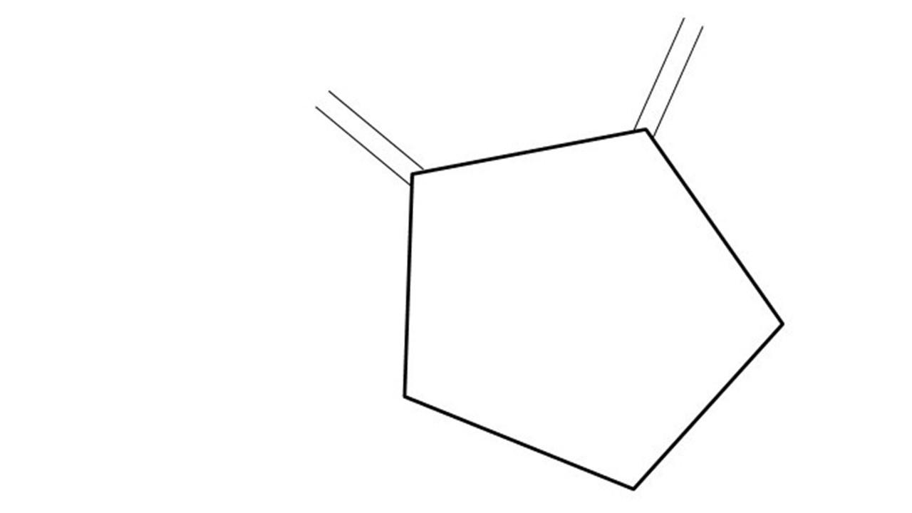
GCBASIC
PIC16Fxxxx chip Family ( Legacy )
Part 4 – sequence the LEDs
January 2025

Slide 3
GCBASIC
Like and subscribe!

Slide 4
PIC16Fxxxx
PIC16Fxxxx is a high performance PIC16
Digital and Analog peripherals
8 –bit or 10-bit ADC
Multiple communication interfaces
Serial, I2C and SPI
PWM – CCP/PWM and 16Bit
The PIC16 offers 8, 14,18,20, 28, 40 and 48-pin packages to support customers in a wide variety of applications.

Slide 5
Videos...
Install the hardware and make the board work – make LEDs work
Make four LEDs flash in a sequence
Set the LEDs to represent the value of ADC
Sequence the LEDs with a delay using the value of ADC
Using an input to set the state of the LEDs
Using the reset switch
Using the switch, ADC – make the LEDs flash in a sequence with reverse
Using the serial to display values
Using the timer0 overflow, 8bit timer, 16bit timer to flash the LEDs
Using EEProm – showing values on the serial terminal, and more constants insights
Using I2C with serial to discover I2C devices
Using an I2C GCLD display
Using a SPI GCLD display
Using PWM, many ways, to dim the LEDS
Using an external interrupt to control an LED
Using storage within the chip – Progmem, EEPROM and DATA blocks
The GCBASIC tool chain
Assembly , alternatives assemblers and MPLAB-X
Summary

Slide 6
GCBASIC Compiler
GCBASIC Compiler
GCBASIC is an Open Source compiler for PIC, AVR and LGT microcontrollers
GCBASIC supports the 16Fxxxx chip family

Slide 7
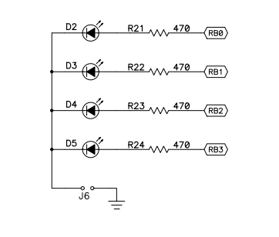
Prerequisites
Assumes you have
Installed the GCBASIC software
Installed your programmer software
Test that you have the PIC attached
You have the 4 LEDs operating
You have a POT connected

Slide 8
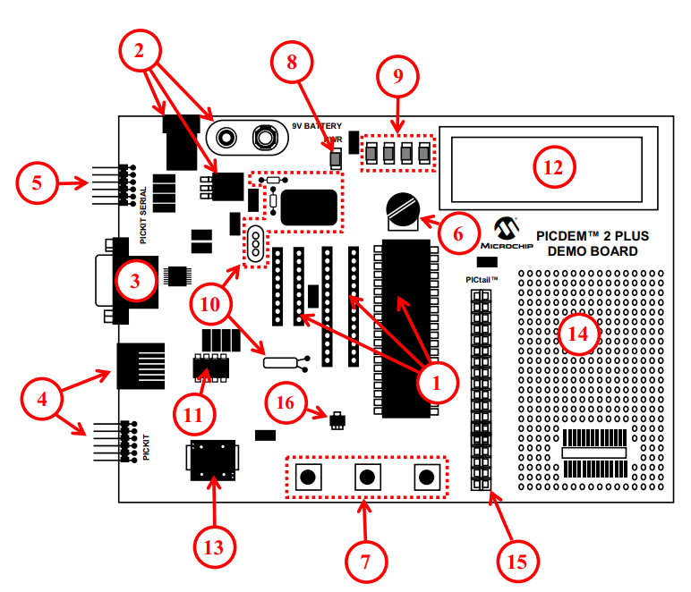
Hardware
The PICDEM 2 Plus Demonstration Board
18-, 28- and 40-pin DIP sockets (although three sockets are provided, only one device may be used at a time)
On-board, +5V regulator for direct input from 9V, 100 mA AC/DC wall adapter or 9V battery, or hooks for a +5V, 100 mA regulated DC supply
RS-232 socket and associated hardware for direct connection to an RS-232 interface
Programmer/debugger connectivity supporting MPLAB® ICD 3, MPLAB REAL ICE, PICkit 2 and PICkit 3
PICkit Serial Connector for analysis of serial communications peripherals such as SPI or I2C™
5 k pot for devices with analog inputs
Three push button switches for external stimulus and Reset
Power-on indicator LED
Four LEDs connected to PORTB
On-board external oscillators including: a) Unpopulated DIP socket for canned crystal oscillator (Y2) b) RC oscillator circuit (R4, C3) c) Unpopulated holes for crystal connection (Y1) d) 32.768 kHz crystal for Timer1 clock operation (Y3)
32K x 8 Serial EEPROM
LCD display
Piezo buzzer
Prototype area for user hardware
Expansion Header for PICtail™ daughter card connectivity or user access to
MCUs
Microchip TC74 thermal sensor

Slide 9
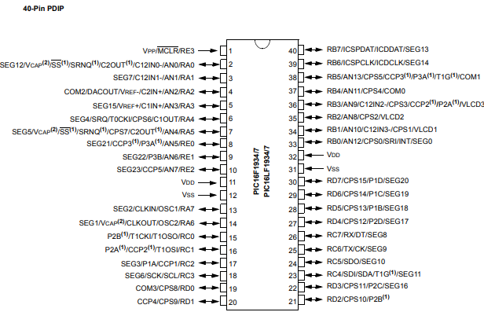
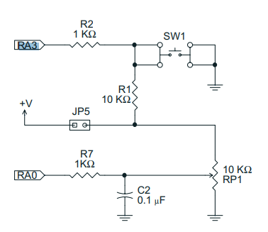
Hardware
SWITCH
RA4

Slide 10
Hardware
Hardware
------------PORTA---------------
Bit#: -7---6---5---4---3---2---1---0---
IO: ----------------------------ADC--
IO: ---------------------------------
------------PORTB----------------
Bit#: -7---6---5---4---3---2---1---0---
IO: ----------------LED-LED-LED-LED--
IO: ---------------------------------
------------PORTC----------------
Bit#: -7---6---5---4---3---2---1---0---
IO: --------------------------------
IO: ---------------------------------
------------PORTD----------------
Bit#: -7---6---5---4---3---2---1---0---
IO: --------------------------------
IO: ---------------------------------
------------PORTE----------------
Bit#: -7---6---5---4---3---2---1---0---
IO: ----------------RST---------------
IO: ---------------------------------
Prototype Board
Power 5v0
Programmer
LEDs & resistors

Slide 11
Time
The tutoral combines previous tutorials by using the Analog-to-Digital Converter (ADC) to control the speed of rotation.
Where speed is a time delay
us, 10us, ms, 10ms, s, m or h
wait time unit
wait 1 ms

Slide 12
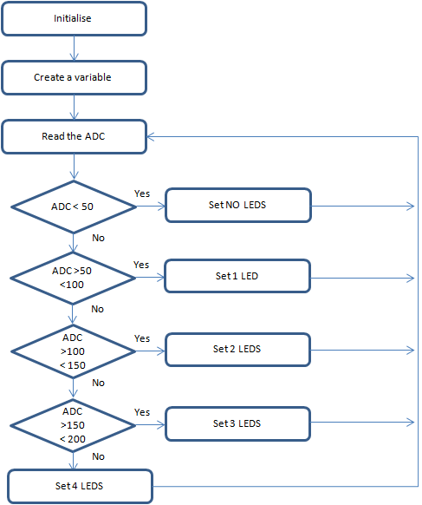
Analog-to-Digital
GCBASIC completes the initialisation
Create a variable to store the ADC results
Read the ADC
GCBASIC makes the process easy via the ReadAD10()
ReadAD10 returns a value of 0 to 1023
Wait for a time period based on returned ADC value
Set the LEDs
Do it again….

Slide 13
Wait
Initialise
Set 1st LED
Read ADC 10 bit
( 0 – 1023 )
Time delays are sometimes key to the operation of a program
Wait for a Delay
Rotate the LEDs
Did it overflow ?
No
Yes
Set 1st LED

Slide 14
Rotate with Carry
 | LEDD3 | LEDD2 | LEDD1 | LEDD0 | CARRY = SREG.0
Start | 1 | 0 | 0 | 0 | 0
Rotate(shift) | 0 | 1 | 0 | 0 | 0
Rotate(shift) | 0 | 0 | 1 | 0 | 0
Rotate(shift) | 0 | 0 | 0 | 1 | 0
Rotate(shift) | 0 | 0 | 0 | 0 | 1
Restart | 1 | 0 | 0 | 0 | 0
Rotate(shift) | 0 | 1 | 0 | 0 | 0

Slide 15
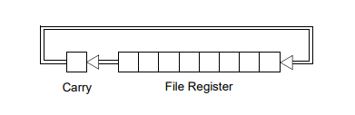
Rotate with Carry
 | LEDD4 = C.4 | LEDD2 | LEDD1 | LEDD0 | CARRY = SREG.0
Start | 1 | 0 | 0 | 0 | 0
Rotate(shift) | 0 | 1 | 0 | 0 | 0
Rotate(shift) | 0 | 0 | 1 | 0 | 0
Rotate(shift) | 0 | 0 | 0 | 1 | 0
Rotate(shift) | 0 | 0 | 0 | 0 | 1
Restart | 1 | 0 | 0 | 0 | 0
Rotate(shift) | 0 | 1 | 0 | 0 | 0

Slide 16
Rotate with Carry
 | LEDD4 = C.4 | LEDD2 | LEDD1 | LEDD0 | CARRY = SREG.0
Start | 1 | 0 | 0 | 0 | 0
Rotate(shift) | 0 | 1 | 0 | 0 | 0
Rotate(shift) | 0 | 0 | 1 | 0 | 0
Rotate(shift) | 0 | 0 | 0 | 1 | 0
Rotate(shift) | 0 | 0 | 0 | 0 | 1
Restart | 1 | 0 | 0 | 0 | 0
Rotate(shift) | 0 | 1 | 0 | 0 | 0

Slide 17
Rotate with Carry
 | LEDD4 = C.4 | LEDD2 | LEDD1 | LEDD0 | CARRY = SREG.0
Start | 1 | 0 | 0 | 0 | 0
Rotate(shift) | 0 | 1 | 0 | 0 | 0
Rotate(shift) | 0 | 0 | 1 | 0 | 0
Rotate(shift) | 0 | 0 | 0 | 1 | 0
Rotate(shift) | 0 | 0 | 0 | 0 | 1
Restart | 1 | 0 | 0 | 0 | 0
Rotate(shift) | 0 | 1 | 0 | 0 | 0

Slide 18
Rotate with Carry
 | LEDD4 = C.4 | LEDD2 | LEDD1 | LEDD0 | CARRY = SREG.0
Start | 1 | 0 | 0 | 0 | 0
Rotate(shift) | 0 | 1 | 0 | 0 | 0
Rotate(shift) | 0 | 0 | 1 | 0 | 0
Rotate(shift) | 0 | 0 | 0 | 1 | 0
Rotate(shift) | 0 | 0 | 0 | 0 | 1
Restart | 1 | 0 | 0 | 0 | 0
Rotate(shift) | 0 | 1 | 0 | 0 | 0

Slide 19
Rotate with Carry
 | LEDD4 = C.4 | LEDD2 | LEDD1 | LEDD0 | CARRY = SREG.0
Start | 1 | 0 | 0 | 0 | 0
Rotate(shift) | 0 | 1 | 0 | 0 | 0
Rotate(shift) | 0 | 0 | 1 | 0 | 0
Rotate(shift) | 0 | 0 | 0 | 1 | 0
Rotate(shift) | 0 | 0 | 0 | 0 | 1
Restart | 1 | 0 | 0 | 0 | 0
Rotate(shift) | 0 | 1 | 0 | 0 | 0

Slide 20
Rotate with Carry
 | LEDD4 = C.4 | LEDD2 | LEDD1 | LEDD0 | CARRY = SREG.0
Start | 1 | 0 | 0 | 0 | 0
Rotate(shift) | 0 | 1 | 0 | 0 | 0
Rotate(shift) | 0 | 0 | 1 | 0 | 0
Rotate(shift) | 0 | 0 | 0 | 1 | 0
Rotate(shift) | 0 | 0 | 0 | 0 | 1
Restart | 1 | 0 | 0 | 0 | 0
Rotate(shift) | 0 | 1 | 0 | 0 | 0

Slide 21
Carry Test
Initialise
Set 1st LED
Read ADC 10 bit
( 0 – 1023 )
Did it overflow ?
If C = 1 then .. Or other test condition
Wait for a Delay
Rotate the LEDs
Did it overflow ?
No
Yes
Set 1st LED

Slide 22
Scale
Initialise
Set 1st LED
Read ADC
Scale transforms an existing value to a new value within a specified scale
Wait for a Delay
Scale()
Rotate the LEDs
Did it overflow ?
No
Yes
Set 1st LED

Slide 23
Workshop
Read the ADC to set the LEDs
Uses
A Byte variable
Simple logic

Slide 25
Videos...
Install the hardware and make the board work – make LEDs work
Make four LEDs flash in a sequence
Set the LEDs to represent the value of ADC
Sequence the LEDs with a delay using the value of ADC
Using an input to set the state of the LEDs
Using the reset switch
Using the switch, ADC – make the LEDs flash in a sequence with reverse
Using the serial to display values
Using the timer0 overflow, 8bit timer, 16bit timer to flash the LEDs
Using EEProm – showing values on the serial terminal, and more constants insights
Using I2C with serial to discover I2C devices
Using an I2C GCLD display
Using a SPI GCLD display
Using PWM, many ways, to dim the LEDS
Using an external interrupt to control an LED
Using storage within the chip – Progmem, EEPROM and DATA blocks
The GCBASIC tool chain
Assembly , alternatives assemblers and MPLAB-X
Summary

Slide 26
GCBASIC
PIC16Fxxxx chip Family ( Legacy )
Part 4 – sequence the LEDs
January 2025

Slide 27
